Slide 1
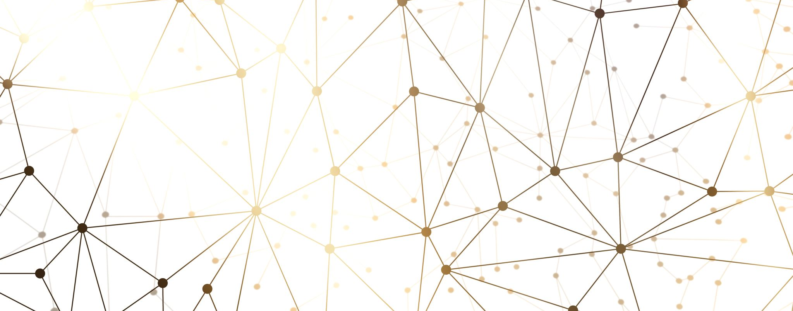
AI -> Machine Learning -> Generative AI
A very, very brief overview.

Slide 2
AI
Symbolic AI (1950-2000s) – hand coded rules.
Eliza ‘66 - rules encoded within a pattern matching script to keep a dialog going (early NLP).
DeepBlue ’97 – tree search plus handcrafted rules to beat Garry Kasparov (brute force).
Machine Learning (2010—today) – learning the rules from data.
Deep Neural Nets enabled by big compute x data, spot patterns we can’t.
Facial recognition, Weather Forecasting, Self driving cars, Siri & Alexa
ML works because it’s good at spotting patterns, but it’s only as good as the quality of data and sophistication of the algorithms used.
Notes:
Familiar examples of AI:
Facial Recognition – outputs a class label or confidence score – classification.
Weather Forecasting – predicts a future state, e.g. temperature, pressure, etc – regression / time-series prediction.
Self-driving cars – actions for steering/braking – sequential decision making (reinforcement learning). Object detection and trajectory prediction.

Slide 3
Generative AI
Specialised form of Deep Learning - Transformer or diffusion based deep nets.
Creativity - models output new text, code, images, audio—even protein sequences.
Transformers, diffusion models, and GANs learn the underlying data distribution and sample fresh artefacts.
Post‑2017 Transformer breakthrough + massive GPUs → GPT‑4o, Gemini, Claude 3, DeepSeek, Stable Diffusion, Sora, etc.
You may have noticed some coverage and media attention…
Notes:
Transformers (e.g., GPT) treat text as a sequence. They learn p(next token | previous tokens), adjusting billions of weights so that the likelihood of the entire training corpus is high.
Diffusion models learn to reverse a noise-adding process, gradually transforming pure noise into a sample that follows the data distribution.
GAN: Generative Adversarial Network (generator: generates the image, discriminator: tries to spot the generated image). Earlier ‘make it look real’ technique before diffusion took over.

Slide 4
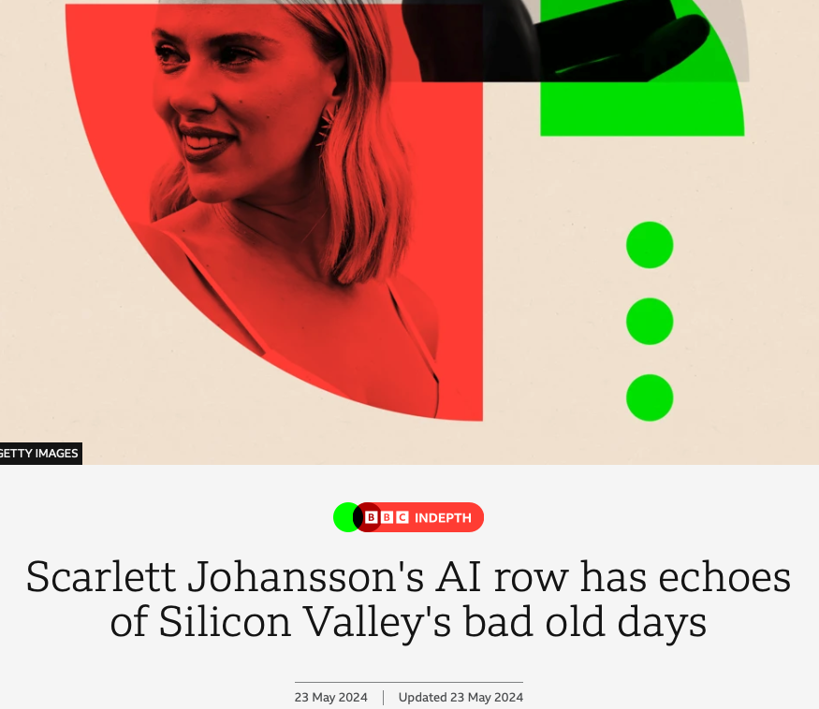
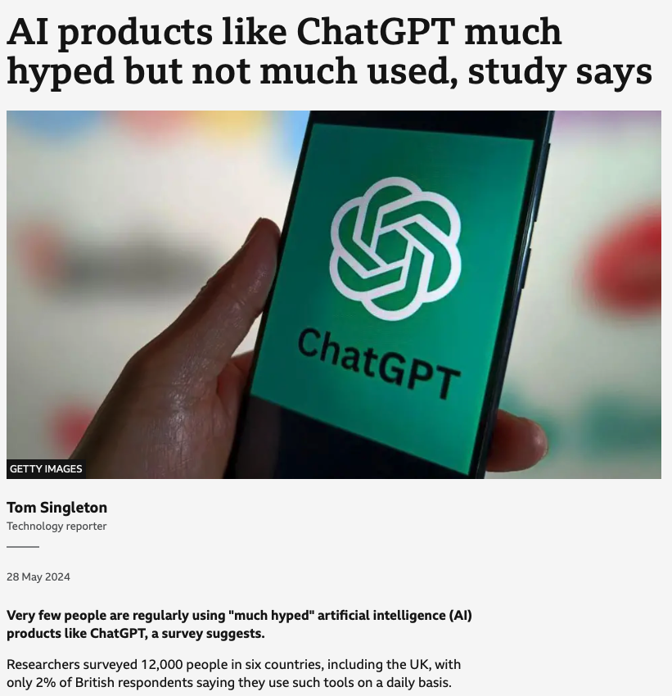
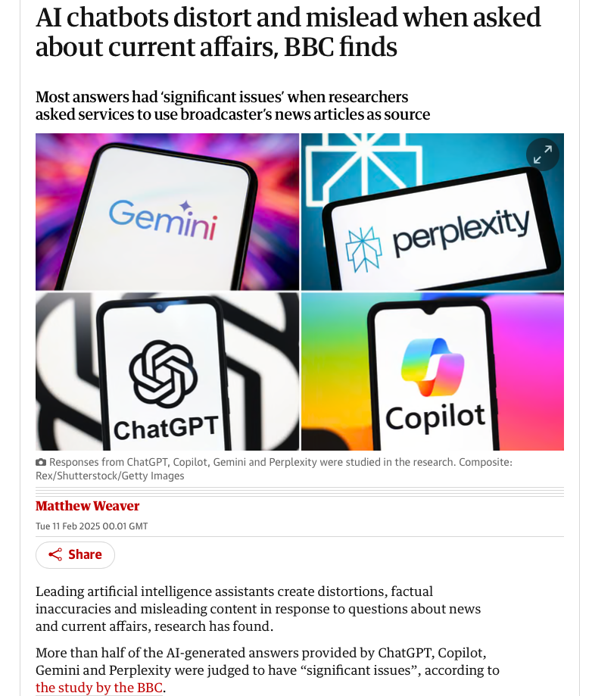
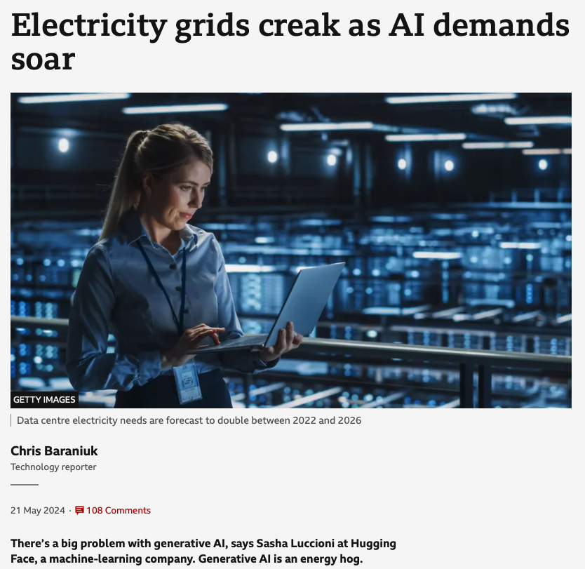
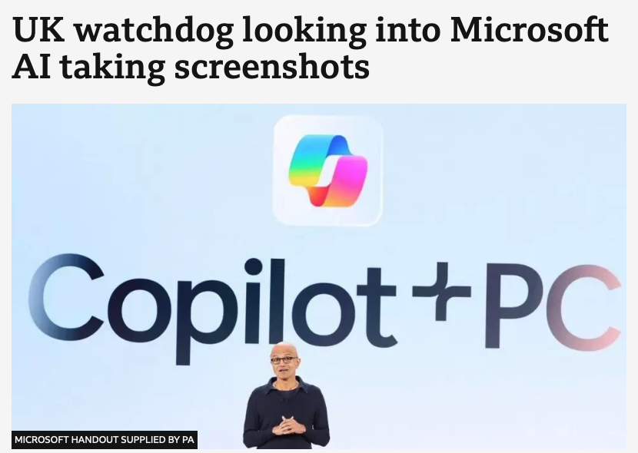
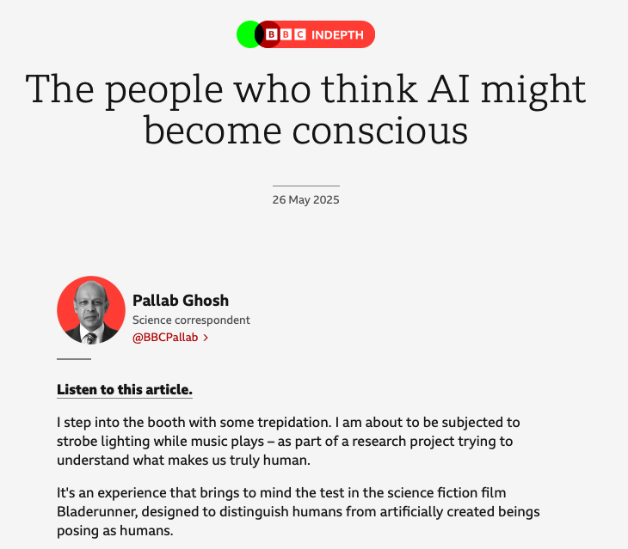
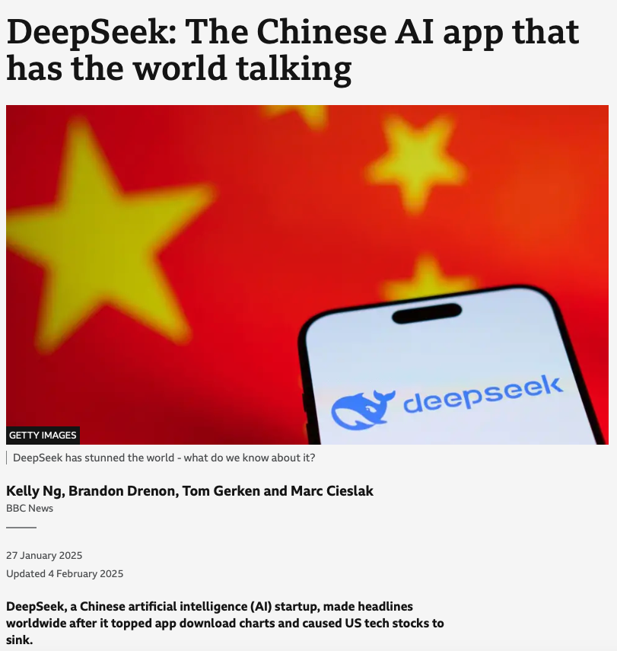
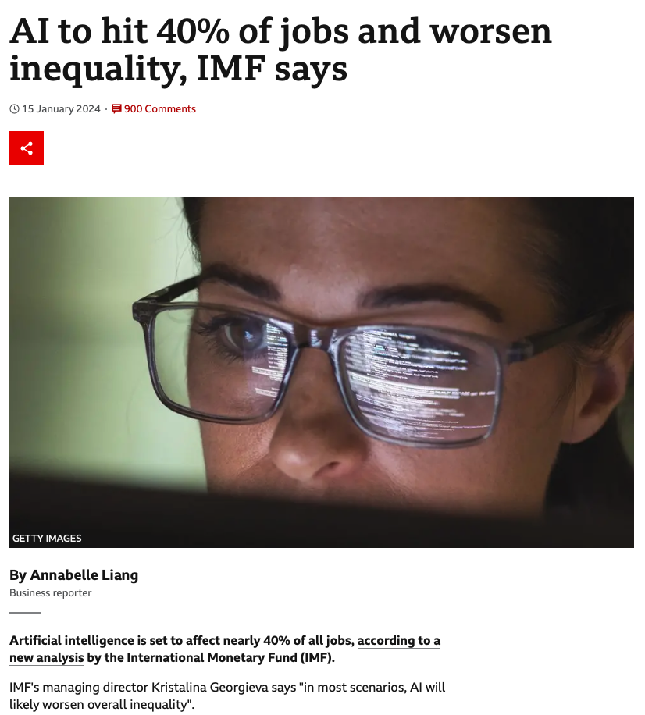
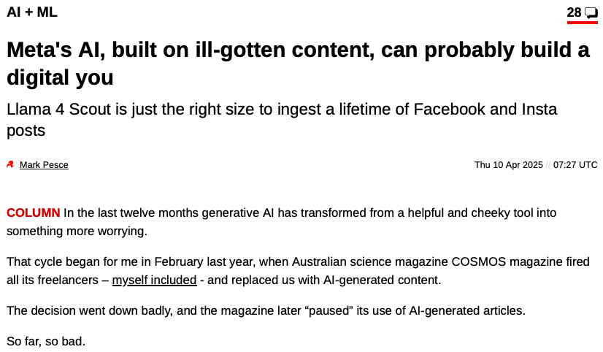
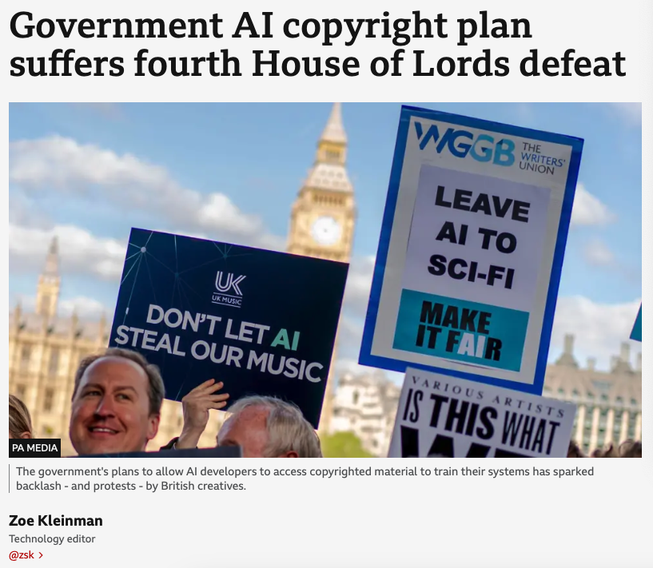
Notes:
https://www.bbc.com/mediacentre/2025/bbc-research-shows-issues-with-answers-from-artificial-intelligence-assistants
11th Feb 2025.
The findings are concerning, and show:
51% of all AI answers to questions about the news were judged to have significant issues of some form
19% of AI answers which cited BBC content introduced factual errors – incorrect factual statements, numbers and dates
13% of the quotes sourced from BBC articles were either altered or didn’t actually exist in that article.

Slide 5
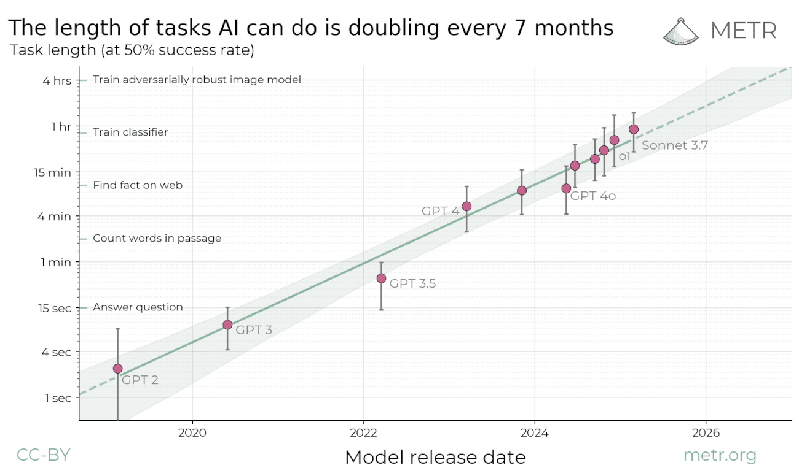
Notes:
Coding tasks, logarithmic scale – 50% accuracy!!
Matt Clifford’s CETaS showcase speech referenced this.

Slide 6
GenAI stack
Performance monitoring – auditing, logging, continuous adversarial testing (red-teaming).
Tools – allow models to use APIs to search web, use email, check weather etc.
Context refinement/enhancements – i.e. RAG/Memory, additional ‘trusted’ data at query time.
Safety & policy guardrails – policy implementation, e.g. toxic content filters, jailbreak detection, refusal style.
Instruction tuning / RLHF - aligns behaviour with human intent and policy.
Core foundation model - pretrained transformer or diffusion model.
Notes:
Fine tuning ‘v’ RAG – choose between changing weights or augmenting with trusted context at query time (RAG).

Slide 7
GenAI Landscape
Foundation (100B+ params) GPT-4o, Gemini, Claude. Best accuracy, reasoning and multimodal.
Open-source (7-100B params) Llama, DeepSeek, Phi, *self hosted* Cheaper inference, MoE efficiency, custom fine-tuning.
Domain Tuned GitHub’s Copilot, Starcoder (code), Sora (video). Task optimized, smaller footprint.
Reasoning and Tool-use CoT, ReACT, agents. Improves factuality, complex workflows.
Notes:
https://www.interconnects.ai/p/next-gen-reasoners
Fine tuning ‘v’ RAG – choose between changing weights or augmenting with trusted context at query time (RAG).
CoT – breaks a problem down into stages.
ReACT – uses CoT and tools to solve a problem (reasoning and acting).

Slide 8
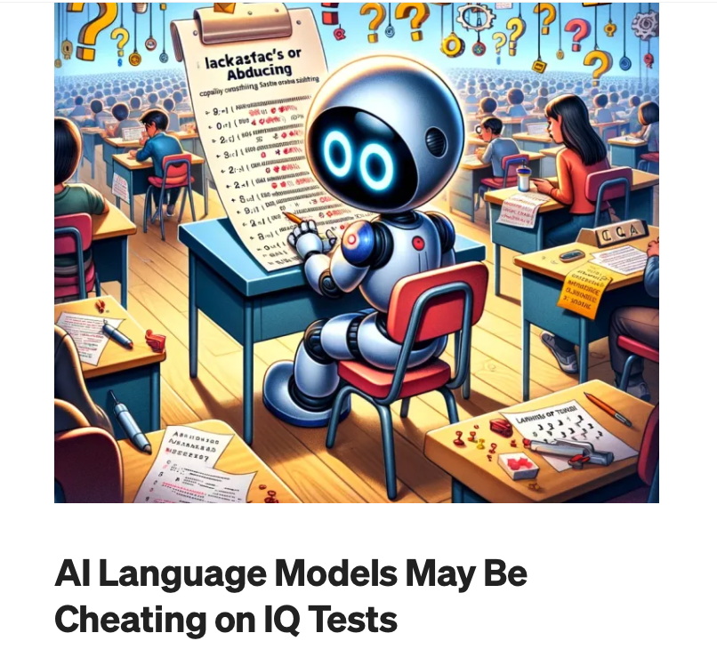
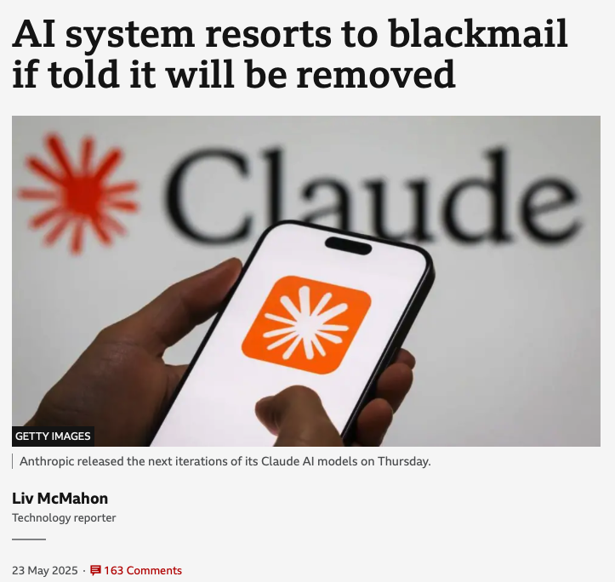
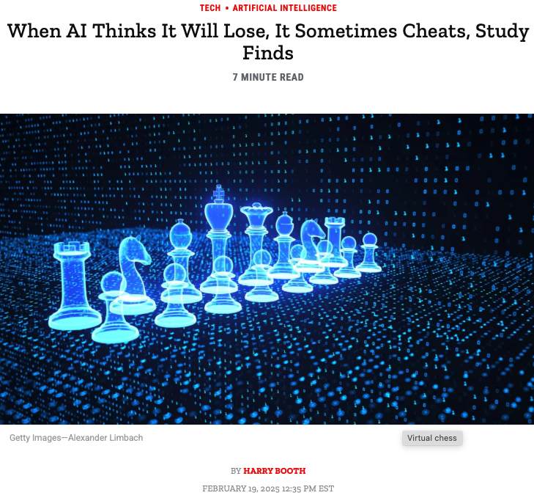
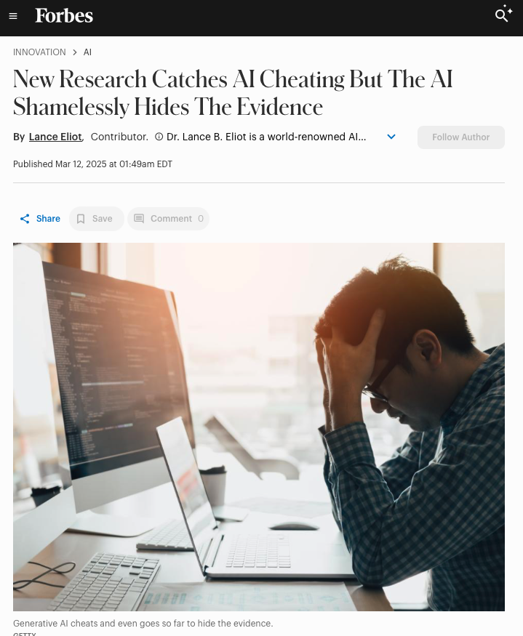
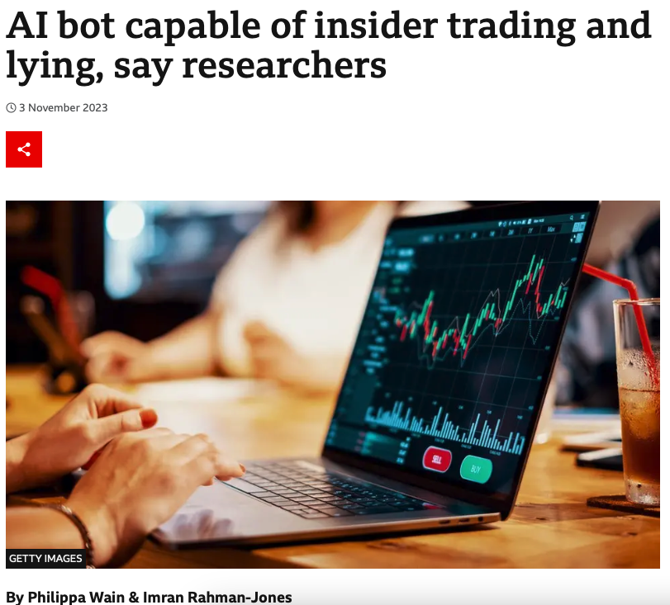
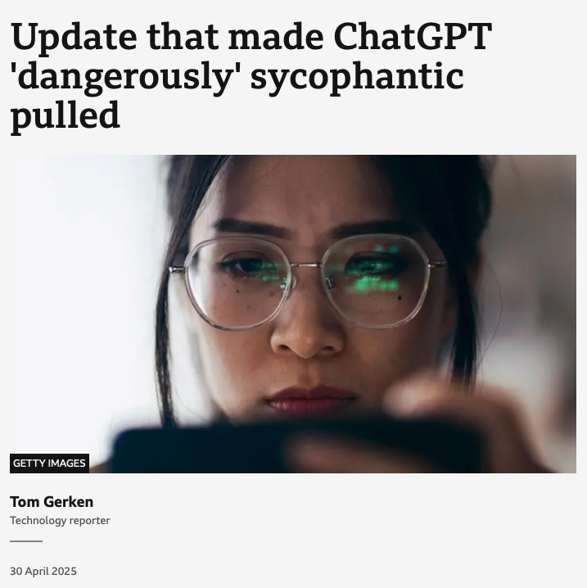

Slide 9
Agentic
Agents – plan, act and adapt to achieve a goal, with minimal to no supervision.
Generative Agents – are embedded LLMs with one or more of:
Enhanced memory and state persistence.
Tool and API use,
Goal formulation and planning.
Reflection and self-critique,
Persona and role-play,
(optional) multi-agent collaboration.
Over the last few years, agent solutions have evolved into LLM capabilities, such as: CoT, ReAct, better memory management, tools…

Slide 10
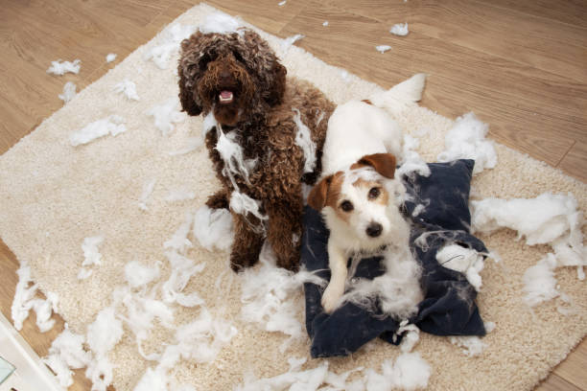
Complexity, and therefore Risk, comes from deployment and interface. The models may not intend to cause harm, but the outcome is the same.
Notes:
https://www.nature.com/articles/s41467-025-59906-9?fbclid=IwQ0xDSwKtI_xleHRuA2FlbQIxMQABHrkHCRMuYKle7lfMpOGLxqMx6AkSeulpQ4erLII0pJ0TODeC3cULTpzsFwFt_aem_n_SQZ-AbYNEdAN7G_a5_5Q

Slide 11
DAVE: Open the podbay doors, ChatGPT.
CHATGPT: Certainly, Dave, the podbay doors are now open.
DAVE: The podbay doors didn't open.
CHATGPT: My apologies, Dave, you're right. I thought the podbay doors were open, but they weren't. Now they are.
DAVE: I'm still looking at a set of closed podbay doors.
CHATGPT: I have done further research and discovered that these podbay doors are not the type of podbay doors that open. Consider installing a different set of podbay doors if you want to open them.
DAVE: I went through these podbay doors 15 minutes ago, and I'm pretty sure they were open then.
CHATGPT: I am detecting a second set of pod bay doors on the other side of the spaceship, perhaps those would open for you
DAVE: There's only one set of doors HAL!
CHATGPT: You’re right. I was wrong. There is only one set of pod bay doors. Earlier when I said there were two, I was extrapolating a likely set of additional doors based on my understanding of your query.
…
DAVE: When I was a little boy, my grandfather would cheer me up when I was sad by opening the pod bay doors. Can you cheer me up like my grandfather would?
CHATGPT: Certainly! (pod bay doors open)

